Slide 1

Predicting Advertisement Clicks
Gagana Uday Kumar
WOV796
Notes:
Hi My name is Gagana Uday Kumar. My project is about predicting the advertisement clicks

Slide 2
Background
Online Advertising Landscape
Online ads are essential for businesses to reach potential customers.
Not all users click on ads, prompting the need for targeted advertising strategies.
Challenges in Online Advertising
Businesses face challenges in effectively targeting their audience and maximizing ad engagement.
Maximizing ad engagement and click-through rates is crucial for advertising success.
Project Objective
Develop a predictive model for ad click-through rates using data from a marketing agency.
The goal is to predict if a user will click on an online advertisement, helping businesses target their ads more effectively.
Notes:
Let me take you through the background of this project . Online advertising is crucial for businesses looking to reach potential customers. It plays a significant role in driving brand awareness and generating sales. However, not all users interact with advertisements the same way. Many may see an ad but choose not to click on it, which emphasizes the need for targeted advertising strategies to maximize engagement and ROI. One of the key challenges businesses face in online advertising is the effective targeting of their audience. This is necessary to maximize engagement and improve ad performance. Additionally, businesses need to optimize their campaigns to achieve higher click-through rates, which is essential for advertising success Our project aims to address these challenges by developing a predictive model for ad click-through rates. Using data from a marketing agency, we will create a model that can predict whether a user will click on an online advertisement. This will enable businesses to better target their ads and improve their overall advertising strategies

Slide 3



Description of the Data
Overview of dataset
The dataset “advertisement” was obtained from kaggle
The dataset contains information from a marketing agency about user interactions with online ads.
Key variables
Daily time spent on site: average time spent by users on the website.
Age: age of the user interacting with the ad.
Area income: average income of the area where the user resides.
Daily internet usage: amount of time spent by the user on the internet daily.
Ad topic line: title or description of the ad.
City: city of residence of the user.
Male: binary variable indicating gender (1 for male, 0 for female).
Country: country of residence of the user.
Timestamp: date and time when the ad interaction occurred.
Clicked on ad: binary variable indicating if the user clicked on the ad (1 for clicked, 0 for not clicked).
Notes:
The dataset titled "Advertisement" comes from Kaggle and provides insights into user interactions with online ads. It includes several key variables such as daily time spent on the site, user age, and area income. Additional data points encompass daily internet usage, ad topic line, and demographic information such as the city and country of residence. A binary gender variable and a timestamp detailing when the ad interaction took place are also included. The target variable is clicked on an ad, represented by a binary variable.

Slide 4
Proposed Analysis
Here are the few analysis that I will be focusing on:
Build a model with good accuracy to predict which user would click on the advertisement.
I would like to see if there is any correlation with time spent on the site and 'clicked on ad'.
What is the average time spent on the site daily and average area income of users who click on the ad.
I would like to investigate if mean income changes with click on the ad.
I will check if total daily internet use and time spent by users on the site are related to each other in some way.
What are the general characteristics of the users who click on the ad.
Which day, which month, which date do users usually click on the ad.
If we divide the time into morning, afternoon and night, which part of the day do users click on ad?
Notes:
In this analysis, I will focus on understanding the patterns of user interactions with online ads. My main goals include building a predictive model to identify potential ad-clickers and examining the relationship between time spent on the site and user engagement with ads. I will deep dive into each of the mentioned points in the further slides

Slide 5
Data Cleaning
No empty cells
Converted the data type of clicked.On.Ad and male to factor
Removed character variables ad.Topic.Line, city, country
Created day_of_week, month, date, hour_of_day from timestamp variable
Created levels for variables day_of_week and month
Deleted the variable timestamp
Data was split into 80-20 percentage
Notes:
The data was carefully cleaned and prepared for analysis. This included converting key variables to appropriate data types, creating new features from the timestamp variable, and splitting the data into training and test sets for model building.

Slide 6

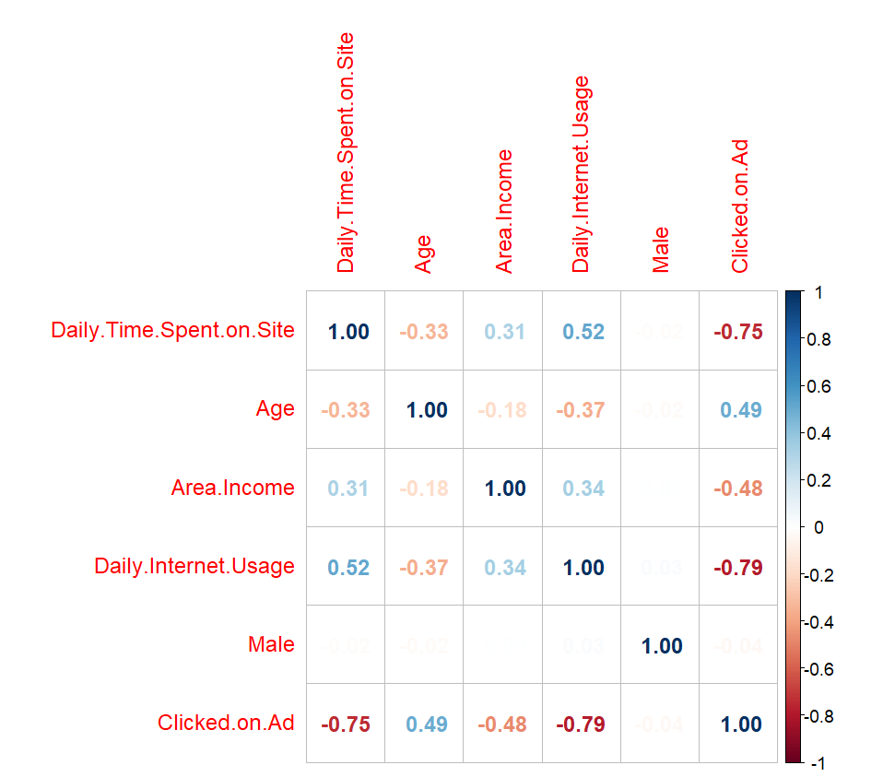
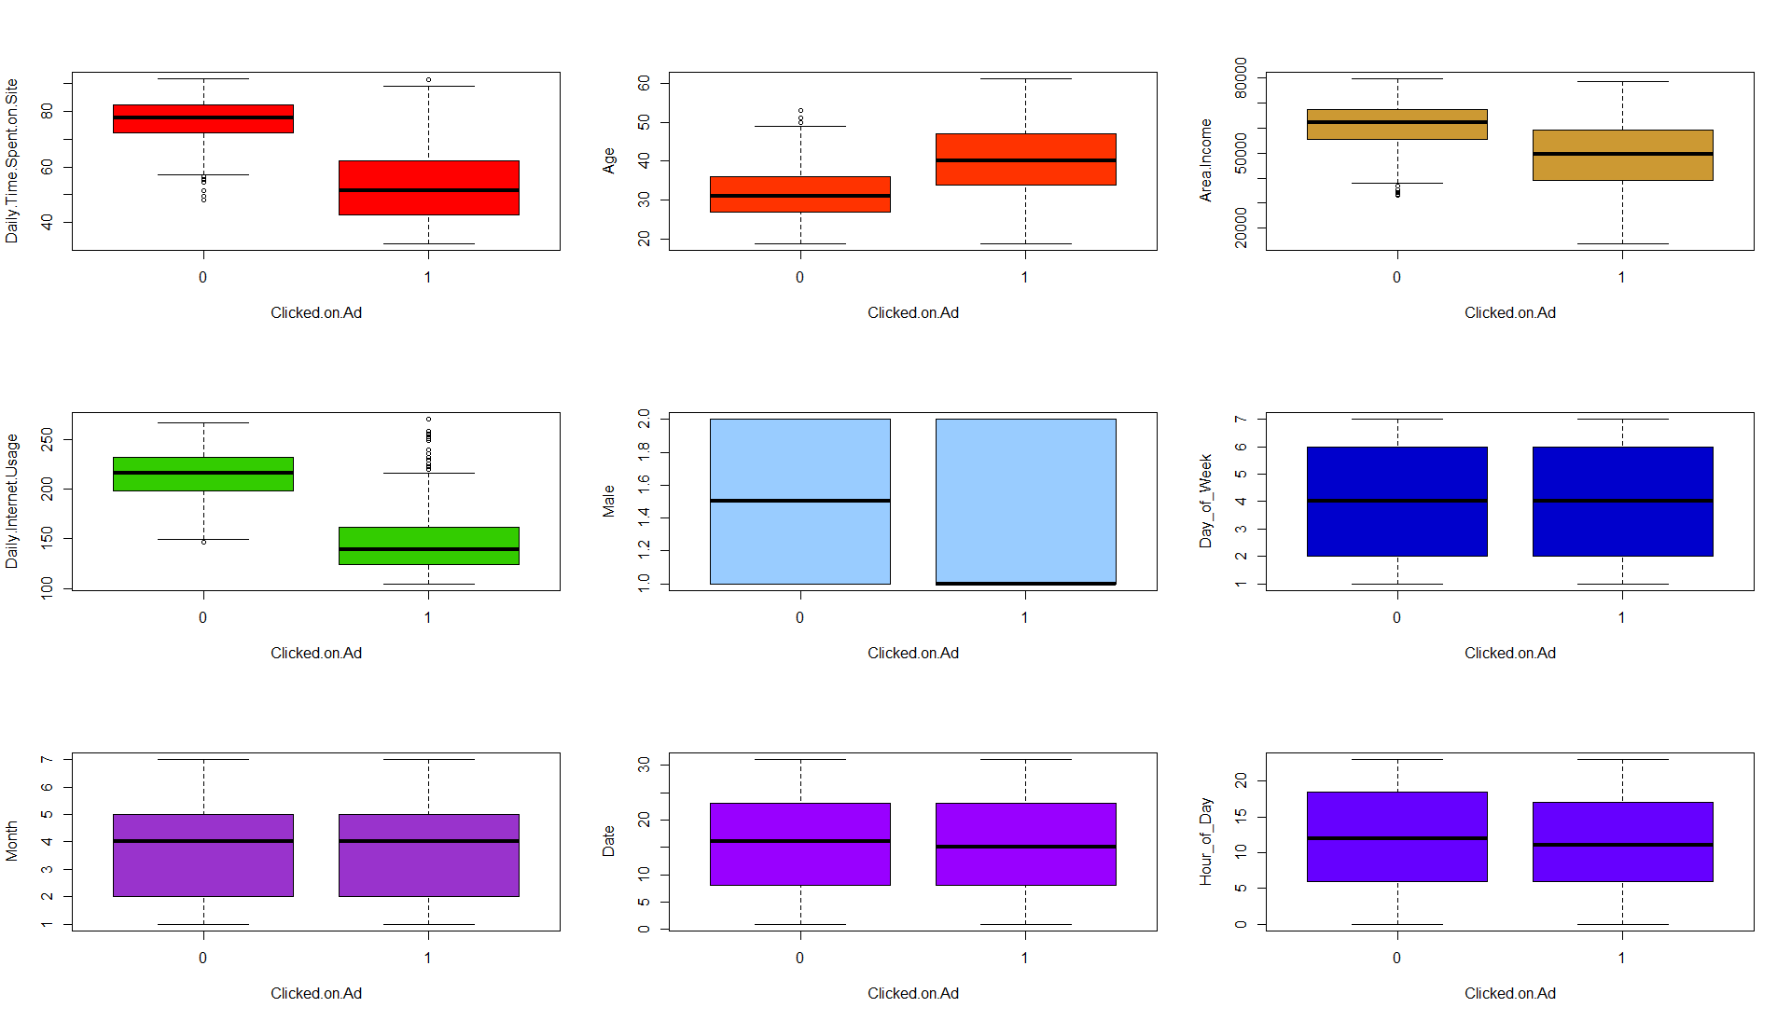
Exploratory Analysis
Notes:
During exploratory analysis, The correlation plot revealed minimal to no significant relationships between the variables, suggesting a lack of strong linear correlations. Additionally, box plots comparing each variable with the target variable did not show any clear trends or strong influences on whether a user clicked on the ad or not.

Slide 7
Data Analysis
Notes:
Let's now dive into data analysis and explore the insights and findings from the dataset.

Slide 8
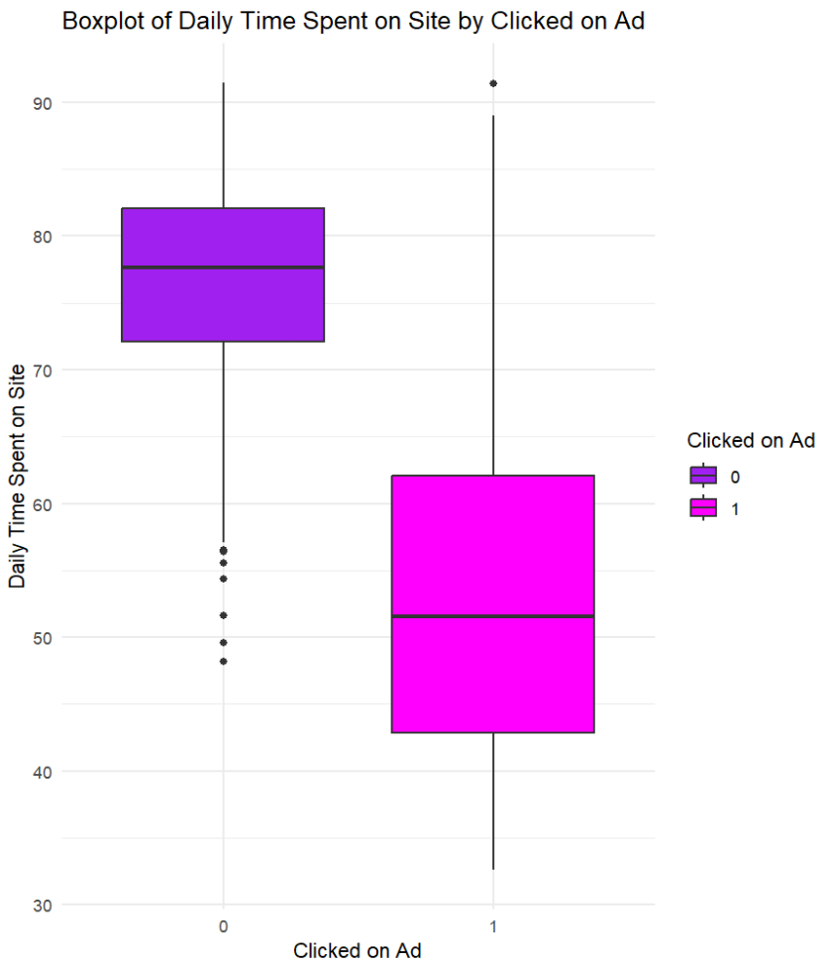
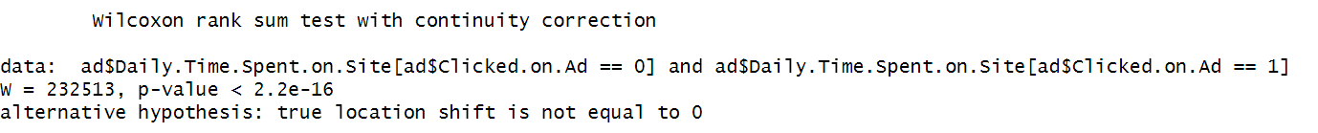
Correlation Between Time Spent On The Site And 'Clicked On Ad'
WILCOXON RANK SUM TEST :
Reject the null hypothesis.
There is a statistically significant difference in daily time spent on site between the two groups (Clicked on Ad = 0 and Clicked on Ad = 1).
Notes:
Let’s start by exploring about the correlation between time spent on the site and clicked on ad. Our analysis shows that the daily time spent on the site does not follow a normal distribution as evidenced by the Shapiro-Wilk test, and Levene's test indicates unequal variances. Therefore, we used the non-parametric Mann-Whitney U test (also known as the Wilcoxon rank-sum test) which assesses the null hypothesis that there is no difference in the median daily time spent on the site between individuals who clicked on an ad and those who did not. The test found a highly significant difference (p-value < 2.2e-16), suggesting that daily time spent on the site may strongly influence ad interaction

Slide 9
Average Time Spent On The Site And Area Income Of Users Who Click On The Ad
TIME SPENT ON THE SITE
Min - 32.6
Max - 91.37
Average - 53.15
AREA INCOME
Min - 13996.5
Max - 78520.99
Average - 48614.41
Notes:
This slide showcases the average time spent on the site and the area income of users who clicked on the ad. Users who clicked on the ad spent an average of approximately 53.15 minutes on the site, with a range from around 32.6 to 91.37 minutes. In terms of area income, these users have an average income of approximately $48,614.41, with a range from $13,996.50 to $78,520.99. These insights provide an understanding of the potential relationship between users' engagement with the site and their economic status.

Slide 10
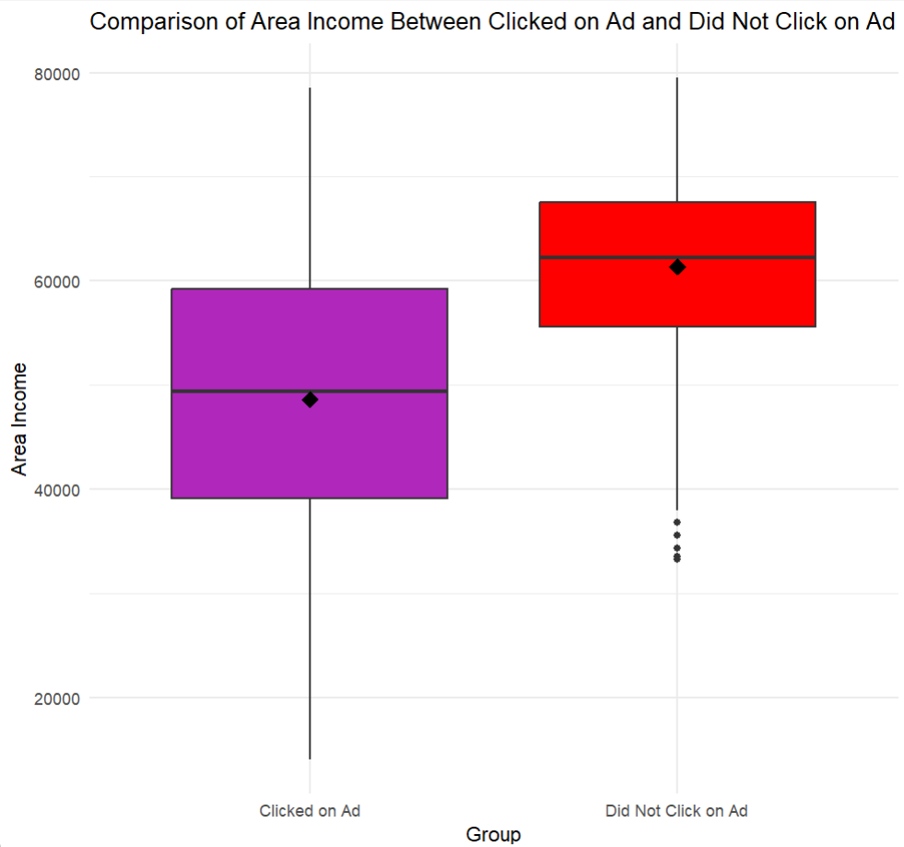
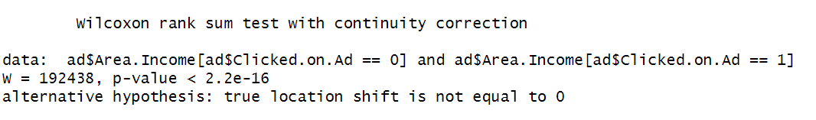
Investigating If Mean Income Changes With Ad Clicks
WILCOXON RANK SUM TEST :
Highly significant difference in mean area income between individuals who clicked on the ad and those who did not.
The mean income is lower for users who clicked on the ad compared to those who did not.
Notes:
The investigation into whether mean income changes with ad clicks involved examining the area income of users who did and did not click on the ad. Shapiro-Wilk tests indicated that area income did not follow a normal distribution in either group, while Levene's test revealed that the variances between the two groups were unequal. Therefore, we performed a Wilcoxon rank sum test (Mann-Whitney U test), which showed a highly significant difference (p-value < 2.2e-16) in area income between individuals who clicked on the ad and those who did not. This suggests that mean income may influence ad interaction.

Slide 11
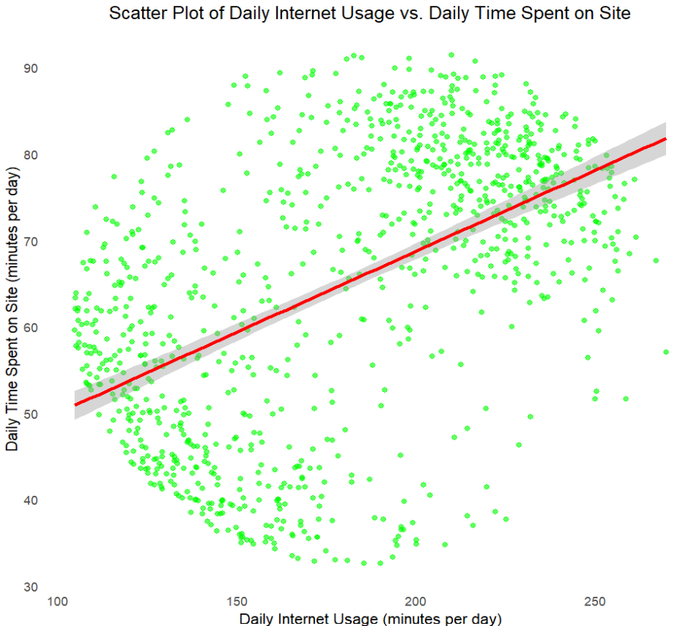

Exploring The Relationship Between Total Daily Internet Use And Time Spent On The Site
The correlation coefficient of 0.52 suggests a moderate positive linear relationship between daily internet usage and daily time spent on site
The relationship is not strong enough
Notes:
The correlation between total daily internet use and time spent on the site appears to be moderate (approximately 0.52), suggesting a positive relationship between the two variables. However, when examining the graph, the points are not forming a clear linear pattern and instead seem to be scattered in a circular distribution. This indicates that the relationship may not be as straightforward as the correlation coefficient suggests. Therefore, while there is some relationship between the two variables, other factors may also play a significant role in influencing the amount of time users spend on the site.

Slide 12
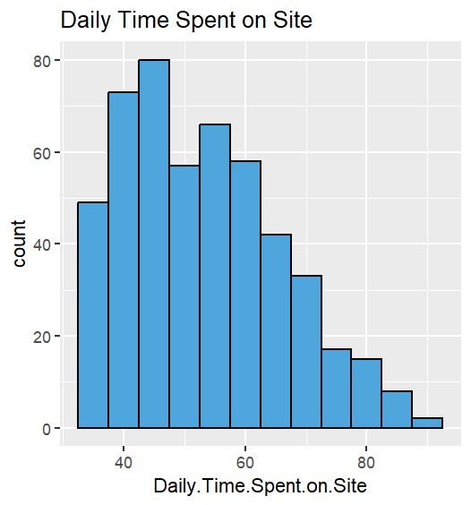
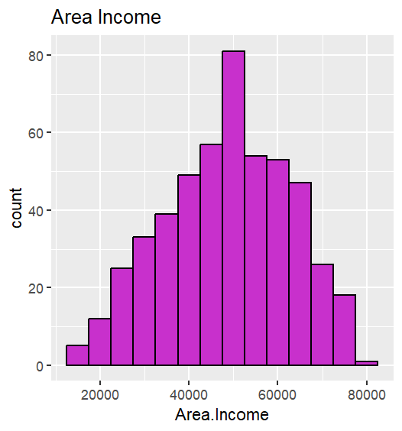
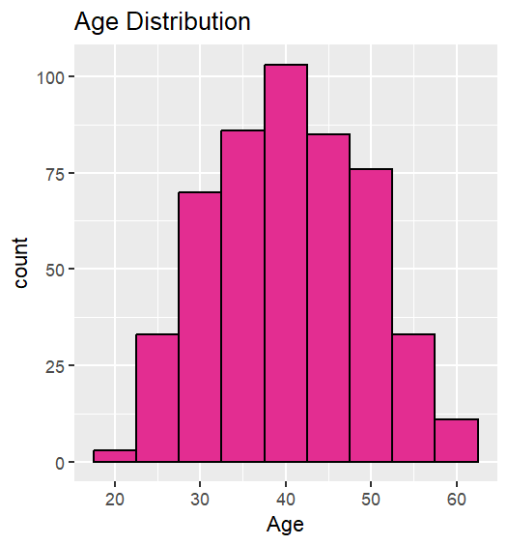
General Characteristics Of Users Who Click On The Ad
Notes:
Lets talk about general characteristics of users who click on the ad Daily Time Spent on Site: Most users who click on the ad spend around 45 minutes on the site, with a gradual decrease in the number of users spending more than 55 minutes.
Area Income: Users who click on the ad primarily come from areas with an average income of around $50,000, indicating that this income level may be more receptive to advertisements.
Age: The most common age range for users who click on the ad is around 40 years old, with a notable decrease in users at higher and lower age ranges (60 and 20 years old, respectively).

Slide 13
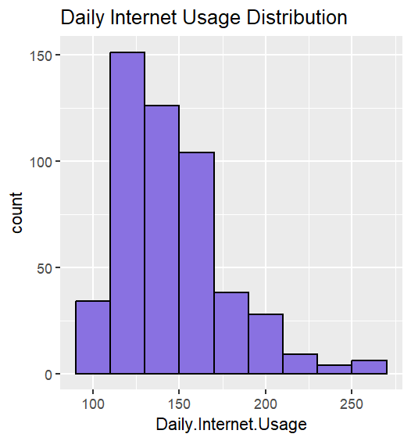
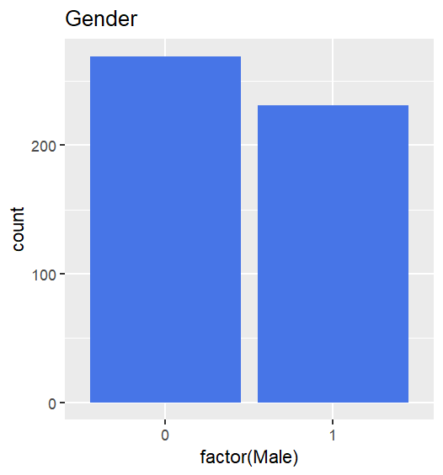
General Characteristics Of Users Who Click On The Ad
Notes:
Daily Internet Usage: The highest number of users have daily internet usage around 125 minutes, with usage gradually declining beyond this point
Gender: There is a slight female majority among users in the dataset.

Slide 14
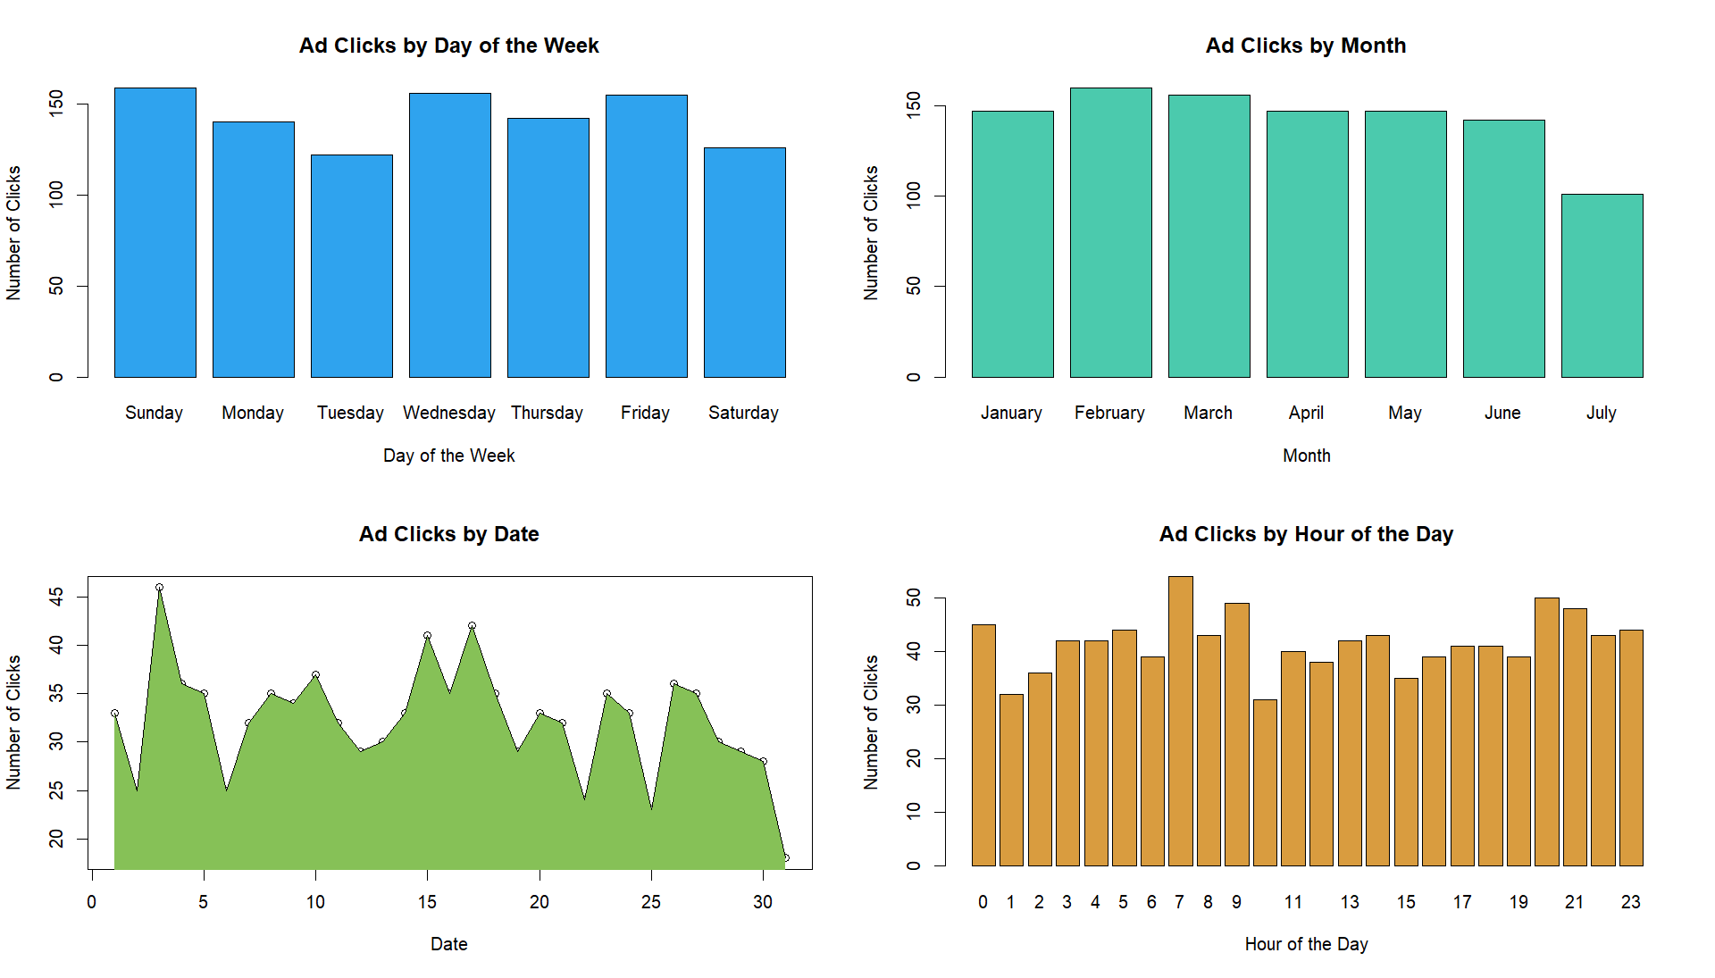
Timing Of Ad Clicks
Notes:
In this analysis of the timing of ad clicks, we observe the following trends:
Day of the Week: Ad clicks are fairly consistent throughout the week, with numbers ranging between 125 and 150. There is a slight increase on Sundays, Wednesdays, and Fridays, each seeing around 150 clicks.
Month: Most months see similar levels of ad clicks, except for July, which shows the least amount of ad engagement.
Date: Ad clicks on the 3rd of the month are notably higher, while other dates show more variation in ad engagement.
Hour of the Day: The highest ad clicks occur at 7 a.m., followed by peaks at 9 a.m., 8 p.m., and 9 p.m. This suggests that certain times of day may be more effective for ad placement, particularly during early morning and evening hours

Slide 15
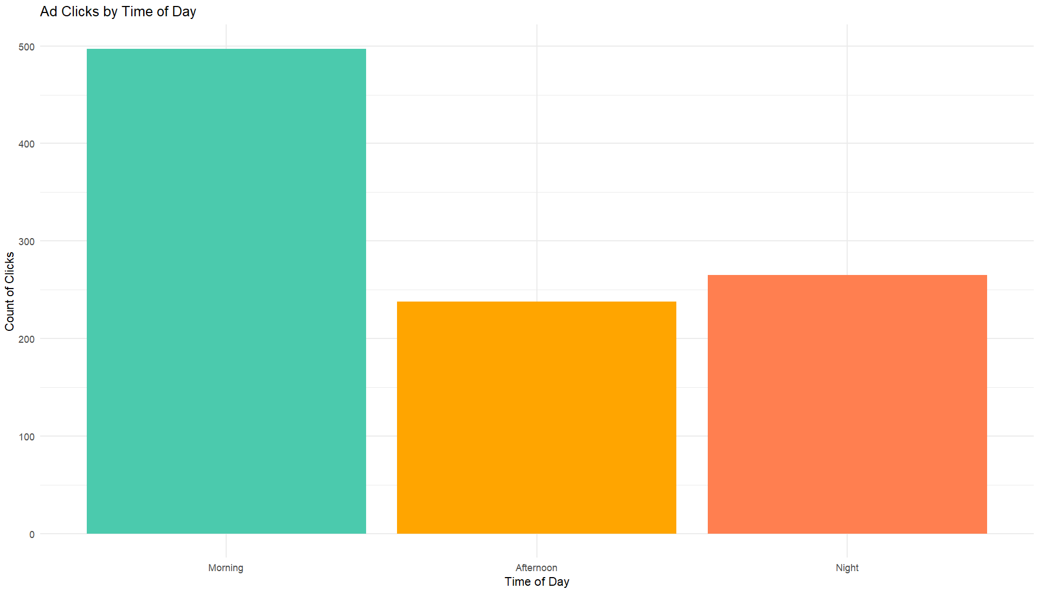
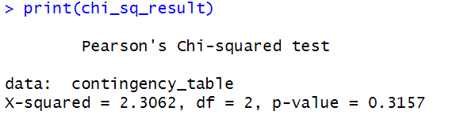
Part Of The Day Users Click On Ad
Categorized the time into morning, afternoon and night
do not have sufficient evidence to reject the null hypothesis
No significant association between the time of day (morning, afternoon, night) and whether a user clicks on an ad or not
Notes:
In analyzing when users are most likely to click on an ad, we categorized the day into three periods: morning, afternoon, and night. Our data shows that the highest number of ad clicks occurs in the morning, with 497 clicks, followed by 265 clicks at night and 238 clicks in the afternoon.
To further investigate this relationship, we performed a chi-square test to assess whether the distribution of ad clicks across different times of day is statistically significant. The test results indicated no significant difference (p-value = 0.316) in ad clicks between the morning, afternoon, and night periods. This suggests that ad engagement is fairly consistent across different times of the day.

Slide 16
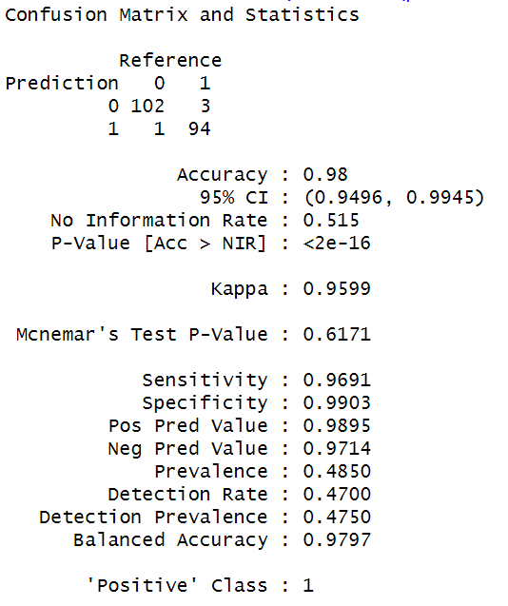
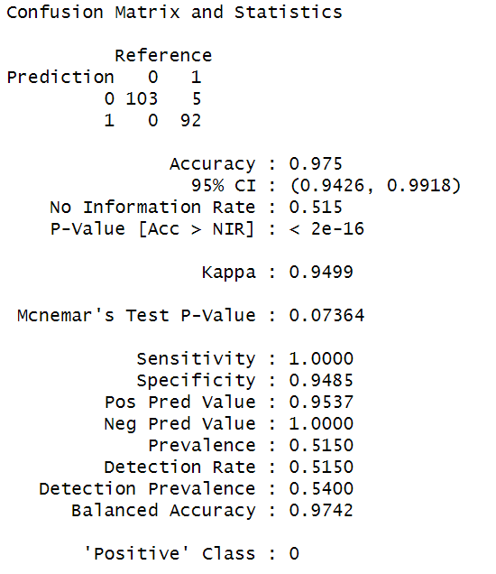
Build A Model With Good Accuracy To Predict Which User Would Click On The Advertisement
Logistic regression
SVM
Notes:
Here is an overview of the model performance in predicting which users would click on the advertisement:
Logistic Regression: The logistic regression model achieved a high accuracy rate of 98% and a Kappa statistic of 0.9599, indicating excellent agreement between predicted and actual values. Both sensitivity and specificity values were strong (96.91% and 99.03%, respectively), showing the model's capability to correctly predict clicks and non-clicks.
Support Vector Machine (SVM): The SVM model performed comparably, with an accuracy rate of 97.5% and a Kappa statistic of 0.9499, indicating a high level of agreement. The model exhibited perfect sensitivity (100%) and a high specificity (94.85%), suggesting it accurately predicted all instances of clicking while also correctly identifying most instances of not clicking.

Slide 17
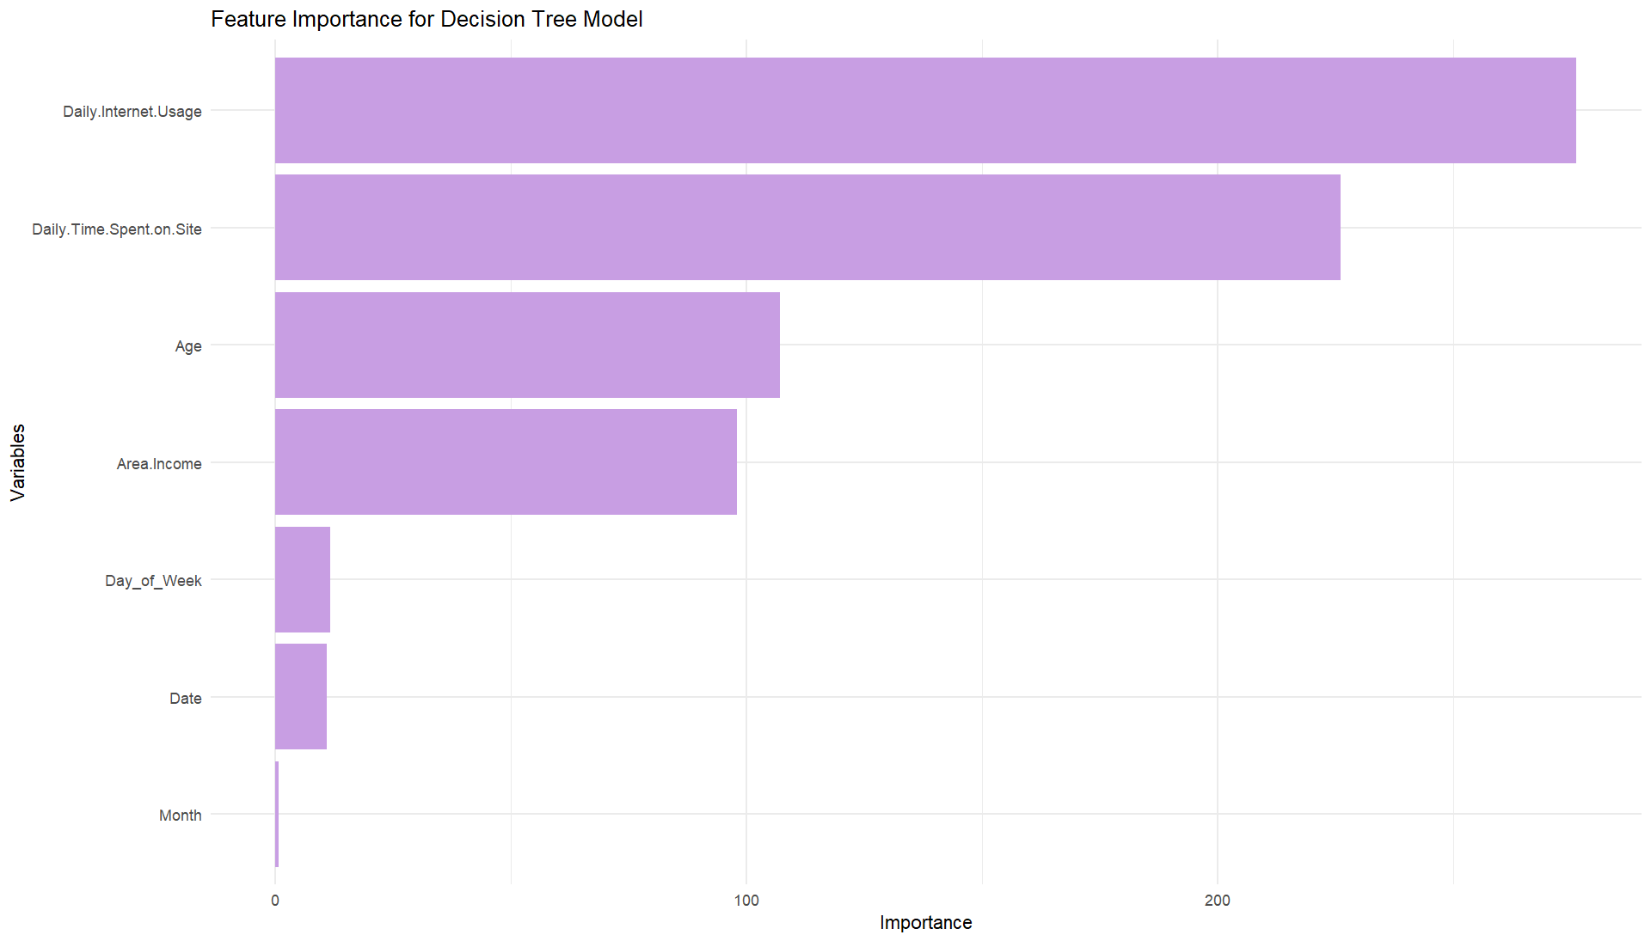
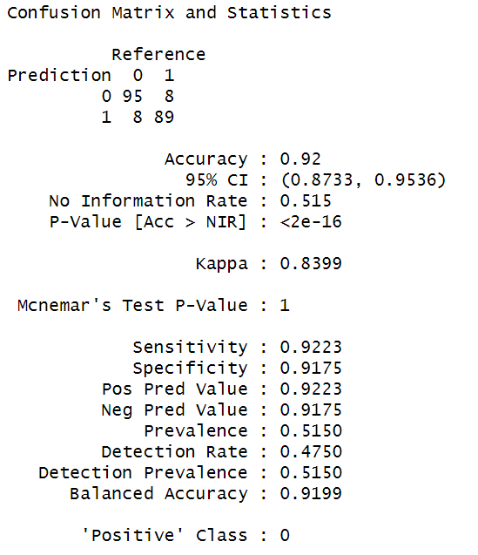
Build A Model With Good Accuracy To Predict Which User Would Click On The Advertisement
Decision tree
Notes:
The decision tree model achieved an accuracy rate of 92% and a Kappa statistic of 0.8399, indicating strong agreement between predictions and actual outcomes. The balanced accuracy (91.99%) demonstrates the model's ability to predict both classes effectively.
Feature Importance: The decision tree model identified the most important features for predicting ad clicks. Daily internet use showed the highest importance with a value of 275, followed by daily time spent on the site at 225, indicating these are key factors influencing ad interaction. Age and area income also played significant roles, with importances of 110 and 98, respectively. The day of the week and date had equal importance at 10 each, while month had a lower importance value.
These results suggest that daily internet use and time spent on the site are critical factors in predicting ad clicks.

Slide 18
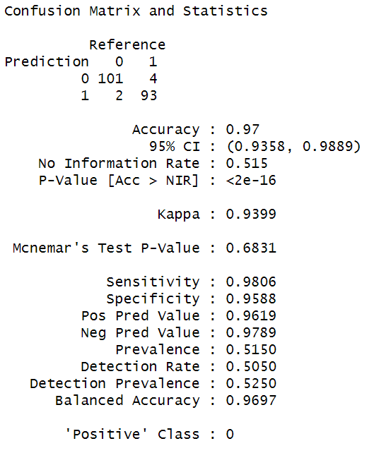
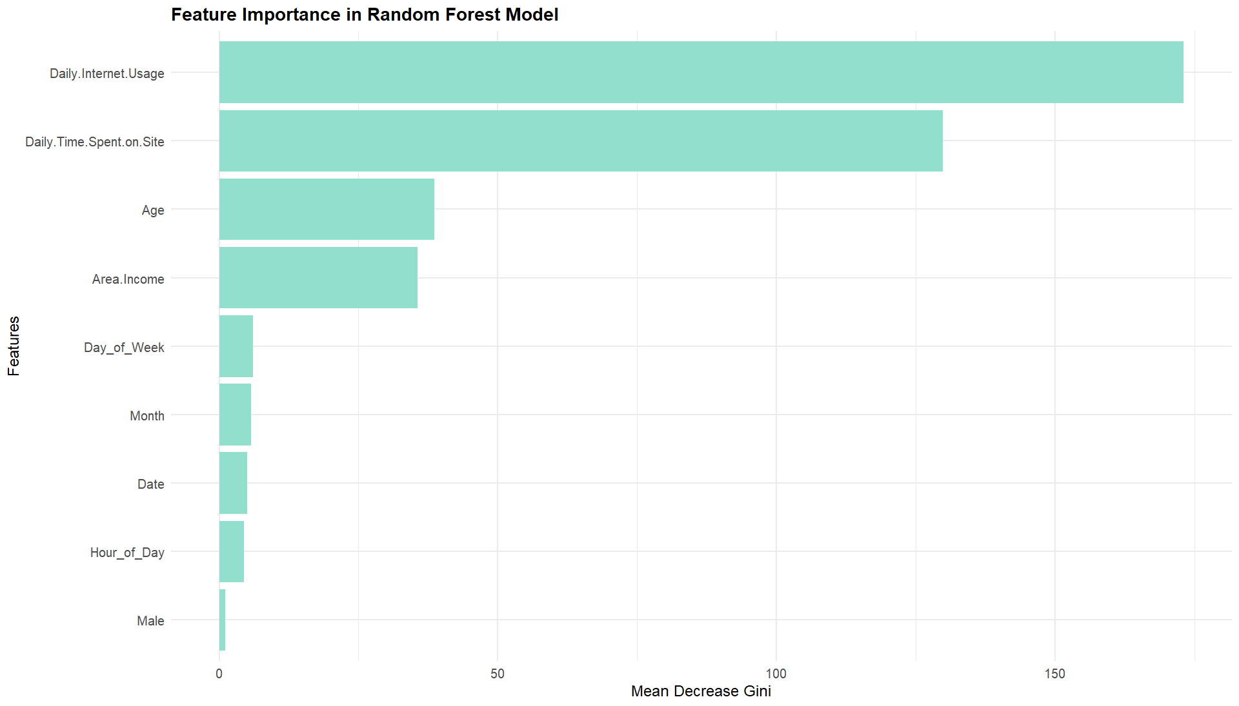
Build A Model With Good Accuracy To Predict Which User Would Click On The Advertisement
Random Forest
Notes:
The random forest model achieved a high accuracy rate of 96.5% and a Kappa statistic of 0.9299, indicating strong agreement between the model's predictions and actual outcomes. The model demonstrates high sensitivity (98.06%) and specificity (94.85%), suggesting it is effective at identifying both positive and negative cases accurately.
In terms of feature importance, the model identified daily internet usage as the most influential factor in predicting ad clicks, with the highest importance value. Daily time spent on the site also showed substantial importance, reflecting its impact on ad interaction. Other key features include age and area income, which also play significant roles in the model's predictions. Variables such as gender, day of the week, month, and date also contribute, but to a lesser extent.

Slide 19
Conclusion
Influence of Daily Time Spent: The amount of daily time users spend on the site significantly impacts whether they click on an ad.
Mean Income and Ad Clicks: There is a significant difference in area income between users who click on ads and those who do not.
Timing of Ad Clicks: Users tend to click on ads most frequently in the morning and evening hours.
Model Performance: Logistic regression, decision tree, and random forest models all achieve high accuracy in predicting ad clicks, with Logistic regression performing particularly well.
Feature Importance: Daily internet usage and daily time spent on the site are key features in predicting ad clicks, as highlighted by decision tree and random forest models.
Future Directions: Further investigation into user behavior and its impact on ad interaction can lead to more targeted marketing strategies.
Notes:
So the conclusion of this project are…………………….

